Slide 1
Synopsis [1] rough storyline
The protagonist lives a peaceful village life after the revival of the ancient kingdom, Gravidia.
Suddenly, a violent earthquake occurred, followed by the rise of the ancient castle into the sky.
The protagonist rushes to check on his fellow villagers, only to see them fall to the ground as their cores detach and fly off towards the floating castle.

Slide 2
Synopsis [2] rough storyline
God appears before you once more, explaining a cult has provided a spirit of a tyrant king power to escape from him. With only the protagonist left unscathed from his attack, God begs the protagonist for his help once more.
(Begging for your help to re capture a tyrant spirit king and his cult providing him powers?)
The protagonist hesitates for a moment but eventually agrees and thus, was granted his blessings to defeat the evil spirit.
Hence, the protagonist sets off to clear the spirit king’s cult.

Slide 3
Synopsis [3] rough storyline
The protagonist feels conflicted attacking the cultists, for they too were also people and not evil spirits.
Eventually, the protagonist steels himself, managing to clear the evil king’s cult and finding a way to get to the floating castle.
The protagonist finally reaches the castle and spots the stolen spirit cores all gathered and still floating above the castle.
But before he could make his way up to the cores, the spirit king ambushes the protagonist.

Slide 4
Synopsis [4] rough storyline
The protagonist is overwhelmed by the strength of the spirit king and receives fatal injuries during the fight.
The protagonist seeks help from the god, who heals him and stays to assist him in the fight.
With god’s help, you eventually defeat the spirit king.
You free the cores and saved the world (? Whr the world come from ‘ –’)

Slide 5
The slides above isn’t even a synopsis O|<
It be more like a rough storyline rather than a summary of the story

Slide 6
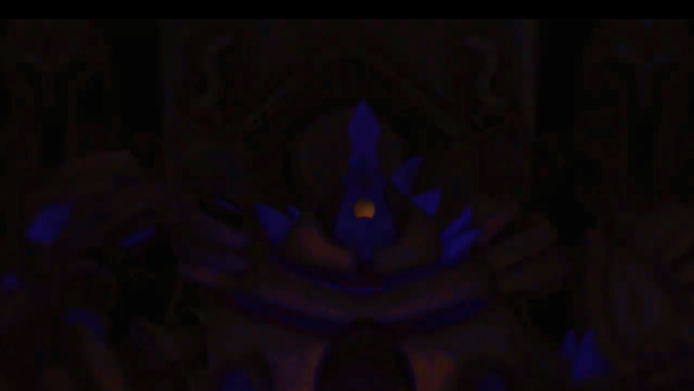
Gravidia: The Sinner’s return

Slide 7
synopsis
The protagonist lives a peaceful village life after the revival of the ancient kingdom, Gravidia.
Suddenly, the village was hit by a sudden earthquake, followed by the ancient Gravidian castle floating into the sky.
The protagonist rushes to the village to check on the villagers, only to find everyone except himself had their cores stolen. The protagonist is then tasked by god to defeat the vengeful spirit king and his cult.

Slide 8
synopsis
The protagonist finds the cult’s hideout and realises he if conflicted about harming the cultists since they were ultimately still people. (this makes no sense. yes I know, whatever happened to everyone unconscious)
He eventually defeat the cult (in one way or another) and manages to get information out of them about the king’s weaknesses before heading to floating castle.
The protagonist reaches the castle and spots the stolen cores. Before he could free the cores, he was unexpectedly ambushed by the king and suffered a fatal wound.
The protagonist tries his best to fight against the king despite his injuries, but quickly realizes the vast difference in strength between him and the king. Despite his efforts, he eventually becomes too weak to continue the fight and was defeated.

Slide 9
synopsis
Having witnessed the protagonist’s efforts, the god heals him and lent a fraction of their power. With god’s power, the protagonist can now fight on par with the king. He uses the king’s weaknesses to his advantage and was able to defeat the spirit king.
The protagonist frees villagers’ cores, saving them all and becomes the village’s hero.

Slide 10
Three act structure [act 1]
Introduction
The protagonist lives a peaceful village life after the revival of the ancient kingdom, Gravidia.
Inciting incident
The village was hit by a sudden earthquake, followed by the ancient Gravidian castle floating into the sky
The problem
All the villagers except the protagonist has their cores stolen. Protagonist is tasked by god to defeat the vengeful spirit king and his cult
Idk where to put this, but protagonist got some power and tools to help with expedition

Slide 11
Three act structure [act 2]
Pinch 1
Protagonist finds the cult’s hideout and realises he if conflicted about harming seemingly regular people. (insert dumb back n forth with own conscience)
Midpoint
Protagonist eventually defeat the cult (in one way or another). He manages to get information out of them about his weaknesses before heading to his castle.
Pinch 2
Protagonist reaches the castle and spots the stolen cores (bait, the most obvious bait smh). Before he could free the cores, he was unexpectedly ambushed by the king and suffers a fatal wound.
Plot 2
The protagonist tries his best to fight against the king despite his injuries, but quickly realizes the vast difference in strength between him and the king. Despite his efforts, he eventually becomes too weak to continue the fight and falls.

Slide 12
Three act structure [act 3]
Climax
Having witnessed the protagonist’s efforts, the god heals him and lent a fraction of their power. With god’s power, the protagonist can now fight on par with the king. He uses the king’s weaknesses to his advantage and was able to defeat the spirit king.
Resolution
Protagonist frees villagers’ cores, saving them all and becomes the village’s hero.

Slide 13
Main events
The protagonist lives a peaceful village life after the revival of the ancient kingdom, Gravidia.
The village was hit by a sudden earthquake, followed by the ancient Gravidian castle floating into the sky
All the villagers except the protagonist has their cores stolen. Protagonist is tasked by god to defeat the vengeful spirit king and his cult
Protagonist finds the cult’s hideout and realises he if conflicted about harming seemingly regular people
Protagonist eventually defeat the cult. He manages to get information out of them about his weaknesses before heading to his castle.

Slide 14
Protagonist reaches the castle and spots the stolen cores. Before he could free the cores, he was unexpectedly ambushed by the king and suffers a fatal wound.
The protagonist tries his best to fight against the king, but the king’s power is too overwhelming. He was defeated despite his efforts.
God heals and shares his power with the protagonist. With more power and knowledge of the king’s weaknesses, the protagonist defeats the king.
Protagonist frees villagers’ cores, saving them all and becomes the village’s hero.
Some parts are summarised, honestly because they look too long inside the shapes

Slide 15
Diverging storyline
1. The protagonist lives a peaceful village life after the revival of the ancient kingdom, Gravidia.
2.1 Protagonist is at home
2.2 Protagonist is at the village
3. The village was hit by a sudden earthquake, followed by the ancient Gravidian castle floating into the sky
unlucky
neutral
lucky
4.3 Protagonist was somehow not hit by falling objects
4.2 Protagonist received minor injuries from falling objects
(start -10% health)
4.1 Protagonist was unhurt by the event
5.1 Protagonist heads to village to check up on others
5.2 Protagonist goes around helping injured people

Slide 16
6.1 Protagonist arrives and sees villagers are unconscious
6.2 The villagers starts falling over for no apparent reason
7. All the villagers except the protagonist has their cores stolen. Protagonist is tasked by god to defeat the vengeful spirit king and his cult
8.1 Protagonist hesitates to accept the task
9.1 God tries to convince protagonist with stronger gear
10.2 Protagonist refused!

Slide 17
11.1 The god begs to the protagonist (and gives him a pitiful look)
12.1 Protagonist accepts the task
12.2 The protagonist dares to refuse the god!
12.1 the god is grateful and blesses the protagonist
(more defense)
13.1 God is furious and casts a curse on the protagonist (misfortune)
Something like roguelike rpg
and teamfight tactics
14.2 god provides the protagonist stronger armour and some tools as promised (more health)
14.3 god tosses some worn armour to the protagonist and threatens his life with the curse if he fails his task
14.1 god provides the protagonist standard armour and some tools

Slide 18
Added bubble so story doesn’t branch off too far (not that it's not already far)
15.1 the protagonist set off and his journey and finds the cult’s hideout
15.1 the protagonist hesitates when he sees intimidating looking cultists, but eventually finds the courage to attack the cult
Changing from conflict with conscience to fear to fit story better
16.1 the protagonist receive some mildly serious injuries from the fight (curse effect, - 5% health)
Splitting extortion of weakness since curse route isn’t developed on (other than it being a joke option)
17.1 the protagonist manages to defeat the cult

Slide 19
Am trying to add meaningful branches to story
I just had to make the story be around luck and blessings
17.1 the protagonist attempts to extort knowledge about the king’s weakness
17.1 the protagonist gets generalised intel about king’s weakness (defeat boss 25% faster)
the protagonist did not manage to get intel on king’s weakness
17.1 the protagonist gets valuable intel about king’s weakness (defeat boss 50% faster)
17.1 Protagonist reaches the castle and spots the stolen cores.
17.1 Protagonist approaches to free the cores
17.1 the situation feels suspicious! The protagonist approaches with caution

Slide 20
17.1 the spirit king ambushes the protagonist and delivers a serious wound! (-30% health)
17.1 the spirit king ambushes the protagonist, but his attack was deflected!
Split outcome? If don’t split, luck and blessing aspect don’t have enough overall impact to story. If split, entire story be self-written story without elements learnt from class.
17.1 enter boss fight!
18.1 Make use of king’s weakness
+ 25% boss takedown efficiency
+ 50% boss takedown efficiency
the protagonist realizes the overwhelming difference of their power
You were defeated by the king
Placeholder for connection

Slide 21
“good” route placeholder
placeholder
god appears and heals you
<- Super summarised event ‘ –’
God lends you a fraction of his power
(defeat without god’s healing but was cursed)
God is once again amazed by your skills to take down such heinous foes. He warns the protagonist of his arrogance and removes the curse. The protagonist continues living his peaceful village life.
You defeat the spirit king and free the stolen cores
(defeat without god’s healing)
God recognises protagonist’s bravery and strength. God appoints protagonist as king/ village head and everyone celebrates
(defeat with god’s healing but was cursed)
God congratulates the protagonist begrudgingly for defeating the spirit king. He removes the curse and lets the protagonist continue his peaceful life. (its weird but I don’t know a better way to write a unwilling character, god has a grudge but since protagonist done his task, can only let them off the hook)
(defeat with god’s healing)
God recognises protagonist’s bravery. God appoints protagonist as hero of the village and everyone celebrates

Slide 22
Hi
Am writing this to (hopefully) clarify the order of how these slides were made
Rough storyline (copied and edited from other docs because im an idiot and somehow didn’t realise assignment is meant to be a sequel)
Summarising and fitting rough storyline into 3 act (and then realising rough storyline probably isn’t even a synopsis)
Branching
Rewriting synopsis (and realising how horrendous this whole slide is)
O|<

